Slide 1
Query Optimization Fundamentals
Improve uptime and performance through query-tuning strategies!
Edward Pollack
Microsoft Data Platform MVP

Slide 2
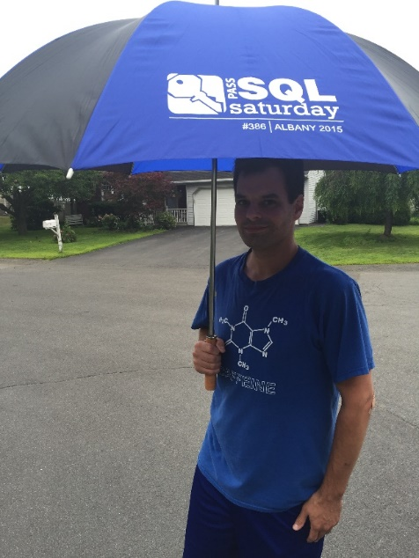






Ed Pollack
Microsoft Data Platform MVP
Published author of:
Dynamic SQL: Applications, Performance, and Security, 2nd Edition
Analytics Optimization with Columnstore Indexes in SQL Server
Expert Performance Indexing in SQL Server, 4th Edition
Published in Expert T-SQL Functions in SQL Server, 3rd Edition
Author on Simple Talk.
Organizes:
SQL Saturday Albany
SQL Saturday New York City
Capital Area SQL Server User Group
Speaker at many data events

Slide 3
Agenda
Why does query tuning matter in 2025?
Common application query problems (and solutions)
Best practices and guidelines
The future!

Slide 4
Why Does This Matter?
Can’t AI do this for me?
Can’t automation solve this?
Isn’t better hardware the solution?
Better app code can solve this, right?

Slide 5
Why Does This Matter?
App/DB Disconnect
Mismatched Standards
Can’t AI do this for me?
Can’t automation solve this?
Isn’t better hardware the solution?
Better app code can solve this, right?
Legacy Code
Business Logic
App Complexity
Query Complexity
Domain Knowledge

Slide 6

Typical Workflow
User complains about poor app performance (IT’S SLOW!)
You are handed no details
Now what?

Slide 7
Basic Workflow for Success
Can the problem be reproduced?
YES ☺ → Profiler/Extended Events/DMV queries to get query text
NO ☹ → Logs to get query info or push back for more info!
Get the query text
Get resource metrics on query execution
Get SQL Server metrics on query execution
Find the cause of latency and resolve

Slide 8

Identify a Query’s Purpose!
Optimization is hard without understanding a query
What is the query’s source?
How often is it executed?
Is the size/shape of the result set sensible?
Who/what is consuming the query output?
Is the thing even used!?

Slide 9
When Do We Stop Optimizing?
Further optimization is too expensive
Point of diminishing returns is reached
An alternate solution is identified
Not all optimization problems require database/query changes to solve!
Performance is now acceptable
Note: Optimal means “fast enough” - not as fast as possible!

Slide 10
Demo
Optimization Tools

Slide 11
Common Optimization Challenges (and Solutions!)

Slide 12
Indexing
Indexes provide efficient table access for common queries.
Do not index every query!
Do not blindly use recommended indexes!
Do not add INCLUDE columns unless needed.
Do check index usage periodically
Remove/tweak unused/underused indexes
Add critical missing indexes
Indexes improve read access at the cost of write speeds and storage.

Slide 13
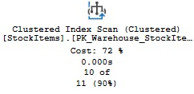
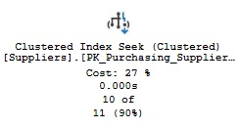
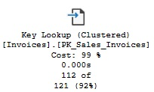
Execution Plan: Seeks, Scans, and Lookups
Scan = Read an entire table/index
Ideal when a large amount of data is needed.
Seek = Narrow search using an index
Best when filtering for a small data set.
Lookup = Need more columns
Good when an index gets performance to be sufficient, without adding more INCLUDE columns.

Slide 14
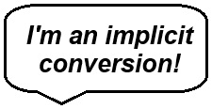
Data Types & Conversions
All data has a data type (!)
When columns of different types are compared…
…SQL Server will try to convert one for you.
For similar data types, this may be OK.
For different data types…
It may throw an error!
It may round/change the value of one column.
If a filter, then an unneeded scan may be forced on the converted column.

Slide 15
Demo
Implicit Conversions

Slide 16
Inefficient Joins & Filters
Filters should reduce data size quickly and efficiently.
Filter/Join columns should be clean and AVOID:
Functions
CAST/CONVERT
OR (this may be a sign of bad logic, too)
CASE
Leading wildcard/fuzzy searches
Move those to a scalar or process elsewhere

Slide 17
Demo
Inefficient Joins & Filters

Slide 18
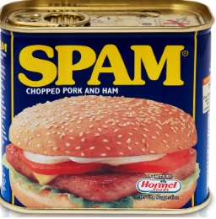
The Spammy Query
Sometimes, a query performs perfectly…
But it is run more often than makes sense!
Often a sign of an application bug or bad design.
Don’t tolerate spam!

Slide 19
Iteration
SQL Server is optimized for set-based operations.
Accessing a table repeatedly is less efficient than all-at-once.
100 rows in 1 query
<>
1 row at a time in 100 queries!
There is a balance between blocking and performance
***It is not subtle***

Slide 20
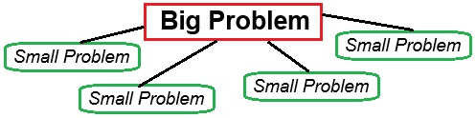
Query Complexity
The optimizer must evaluate many combinations of tables, joins, operators, etc…
More tables/views/functions = more complexity
More chances to not get a good plan
Big problem? Break it into smaller problems!

Slide 21
Demo
Query Complexity

Slide 22

Nested Views/Functions/Triggers/Stored Procs
Encapsulation is not bad, but…
…nesting too many objects creates a lot of complexity
Hard to document
Objects are accessed too many times
Too much business logic in the database = bad
Objects calling objects calling objects calling objects calling objects calling objects calling

Slide 23
Nested Objects: Symptoms
Access against unexpected tables (or too much IO)
Larger execution plan than expected
Latency for a very small/simple query
Unexpected results
Higher row counts than anticipated

Slide 24
Demo
Nested Objects

Slide 25
Parameterization
Execution plan reuse is a very good thing
By default, we want all queries/procs to reuse plans whenever possible
Parameter sniffing is an outlier and not a norm. Do not architect around it. Do not cheat the optimizer.
Local variables incur a poor cardinality estimate as values are not known until runtime. Avoid when issues arise.
This problem is handled very poorly by the internet.
Want more? Check out my parameter sniffing presentation

Slide 26
Hacks and Quick Fixes
Best practices will guide us most of the time.
Outliers should be treated as case-by-case exceptions to best practices
Query hints
Plan forcing
Trace flags
Dynamic SQL
Index spam
Awkward tweaks (IN vs EXISTS, for example)
Hacks are acceptable to solve emergencies, but should not remain forever!

Slide 27
Conclusion
Efficient data access is critical to the success of an application
Our ability to do this is complicated by:
Business logic
Human error
Technical debt
Assumptions
AI can assist with many common issues…
…but falls short on complex/nuanced challenges
Optimization is a valuable skill that leads to better software!

Slide 28
Questions? Thank You!
Find me here:
Ed Pollack | LinkedIn
Edward Pollack | Most Valuable Professionals
https://sessionize.com/edward-pollack/
Find my content here:
EdwardPollack (Ed Pollack) (github.com)
Edward Pollack, Author at Simple Talk (red-gate.com)
Ed Pollack, Author at SQL Shack - articles about database auditing, server performance, data recovery, and more

